Slide 1

Secure and Trusted Decentralized IoT Data Access Management System enabled by Blockchain
Amritanshu 2019 IMT-016
Ankit Rastogi 2019 IMT-018
Rathin R 2019 IMT-081
Tiwari Adarsh U. 2019 IMT-107
ABV-Indian Institute of Information Technology and Management Gwalior-474015

Slide 2
Outlines of the Presentation
Introduction
Motivation
Objective
Methodology
Results
Discussion and Conclusion
Future work

Slide 3
Introduction
Sensing-as-a-service
The rapid expansion of AI and ML among all business activities, that makes collected data by IoTs helpful to make business decisions.
Some companies are not inclined to invest in setting up IoT infrastructure but are willing to pay for reliable data streams. They find it profitable to take access the data from corporations that have such sensors installed.

Slide 4
Introduction
The Internet of Things (IoT) can provide data that may interest the public and organizations. This platform is around IoT data exchanges, where owners of IoT devices can host the data in the blockchain network and interested parties can take access to real-time
or previously recorded data.

Slide 5
Introduction
Why Blockchain technology in IoT data access management system?
Recorded information by an IoT can be very sensitive. i.e., video recorded by a CCTV camera or the information of health measured by wearable devices.
Each transaction is recorded, put into a data block, and added to a secure, immutable data chain so that no one can change it.

Slide 6
Introduction
Ethereum blockchain: Ethereum is a decentralized, open-source blockchain with smart contract functionality.
Smart Contracts: A "smart contract" is simply a program that runs on the Ethereum blockchain. It's a collection of code (its functions) and data (its state) that resides at a specific address on the Ethereum blockchain.

Slide 7
Problems
Centralized Platform: The present state-of-the art marketplaces are based on centralized cloud infrastructure, completely owned by a single organization.
Centralized Storage: In the centralized approach, in an instance where a system error occurs, the entire data can be destroyed.
Trusted platforms: When an organization wants access to some
bulk amount of IoT data, data can be very sensitive, how to make sure if the data provider is a trusted provider or not?

Slide 8
Problems
IoT Data Security and Piracy issues: Data piracy is a big problem for a digital-data accessing business model. So we need to assure that only the individual/business who purchased the access to the IoT data can use it.

Slide 9
Objectives
Decentralized Platform: A decentralized platform for an IoT data access management system. The platform uses a decentralized data streaming network to host IoT data in a sustainable and fault-tolerant way. The platform guarantees privacy-preserving data transmission and storage, and trust metric calculation for all the data providers on the platform.
Self-sovereign identity: Each organization will be provided an ID-based Self-Sovereign Identity (SSI), concept (For user identity) and got authorized on the platform.

Slide 10
Objectives
Trust metric: To ensure that the data sold is genuine and authentic, this platform include a mathematical model named ”Trust score” (TS). ”TS” is calculated using a mathematical formula that is directly proportional to the feedback given by the data consumer and the total number of transactions
performed by the data provider. No centralized authority is involved in the
calculation of TS.
Improvement in IoT data security: Data security will be ensured in this solution; data originating from , the provider is encrypted before it is outsourced to a storage operator and later decryption keys are only available to the client who has made an upfront payment, Means end-to-end encryption (E2EE) on IoT data is applied in this project.

Slide 11
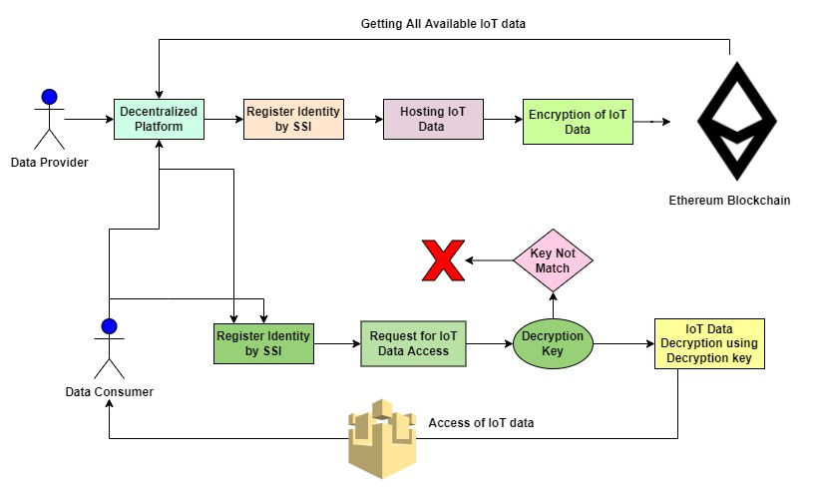
Methodology
Figure 1: complete flow diagram of the proposed platform

Slide 12
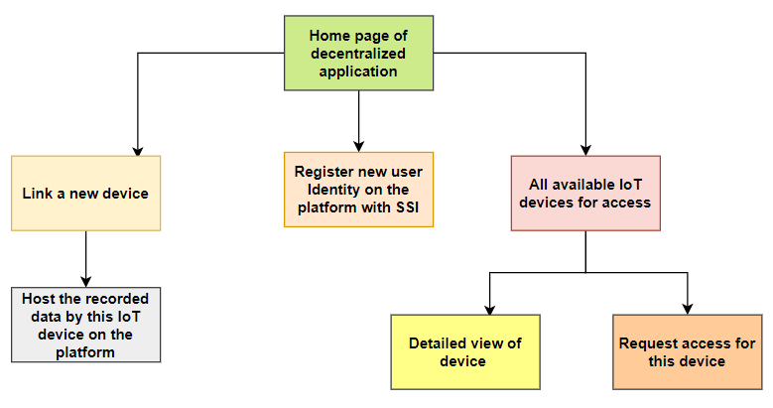
Methodology
Client-side application
Figure 2: Flow diagram of Client-side application

Slide 13
Methodology
Metamask: This is a browser plugin that allows users to make Ethereum transactions through regular applications.
Rinkeby test network: The purpose of the Rinkeby TestNet is to test Ethereum-based Dapps before they are deployed on the Ethereum mainnet.
Remix: This is an open-source Ethereum IDE you can use to write, compile and debug Solidity code. Useful in testing, debugging and deploying of smart contracts. Implemented two smart contracts, and after deployment got the contract address for both the smart contracts. The contract address allows us to connect our DApps with the blockchain. We can access the methods and properties implemented in the SCs in the client-side application by linking with the contract address.

Slide 14
Methodology
Two smart contracts:
[1]
Host the IoT data:
Encryption of recorded data (Advanced Encryption Standard)
For Hosting the IoT data, we need to use a method defined in the
deployed smart contract.
Retrieval of data for all devices
Detailed view of a device (with id_number of device)

Slide 15
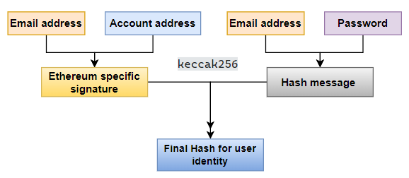
Methodology
[2] Self-sovereign identity: Identity verification plays an important role in the framework as it contributes towards trust building and reputation management of the clients. An identity verification step is mandatory for every actor.
Figure 3: Flow diagram of user identification

Slide 16
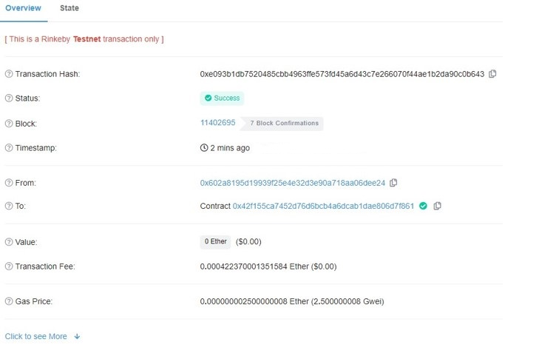
Results
Hosting the data recorded by IoT in
Blockchain:
This "addData" method of the first smart contract creates an object of Title of IoT device and Data itself. Then push the newly created object into the Alldata array. In this step, DApp successfully fetches the user address through the injected metamask in the browser and performs a transaction in the Rinkeby test network. RinkebyETH is paying mode of transaction Fees and Gas Fees.
Figure 4: Transaction record and detail view on Etherscan (with transaction fees and gas fees)

Slide 17
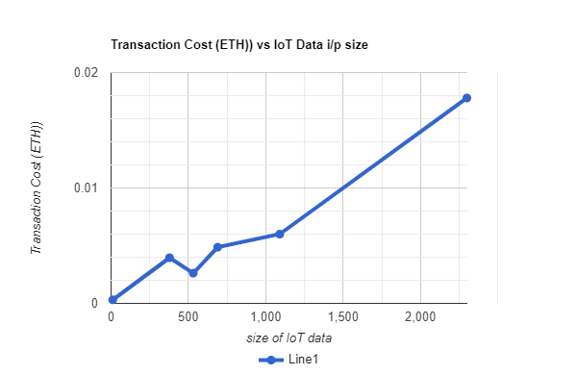
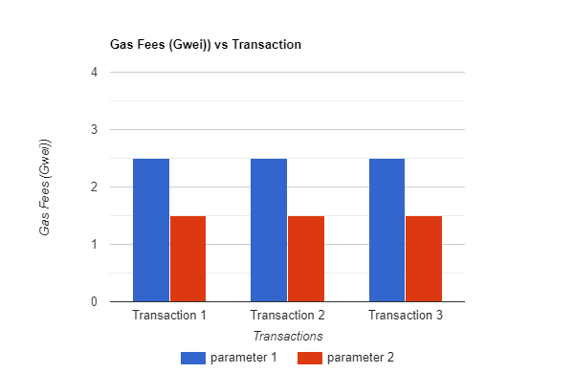
Results
The fees increase as the transaction becomes
more complicated.
To reduce gas fees in these transactions, considering two parameters.
Max base fees: 2.500000016 gwei, Priority Fees: 2.5 gwei, Gas limit: 168948
Max base fees: 2.500000016 gwei, Priority Fees: 1.5 gwei, Gas limit:
168948
Reducing the priority fee can reduce the gas fees
(it can increase the time taken in the transaction by some seconds).
Figure 5: Graph of Transaction cost in ETH and the size of information recorded by the sensor (in bytes).
Figure 6: Gas Fees comparison with two
different parameters

Slide 18
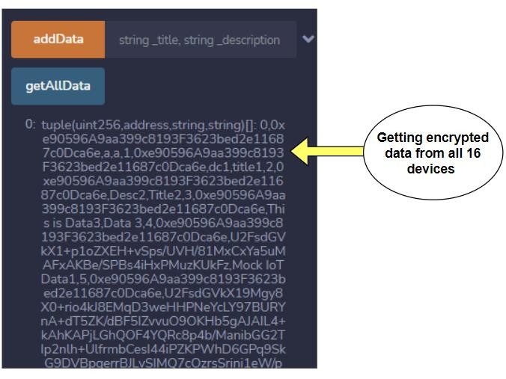
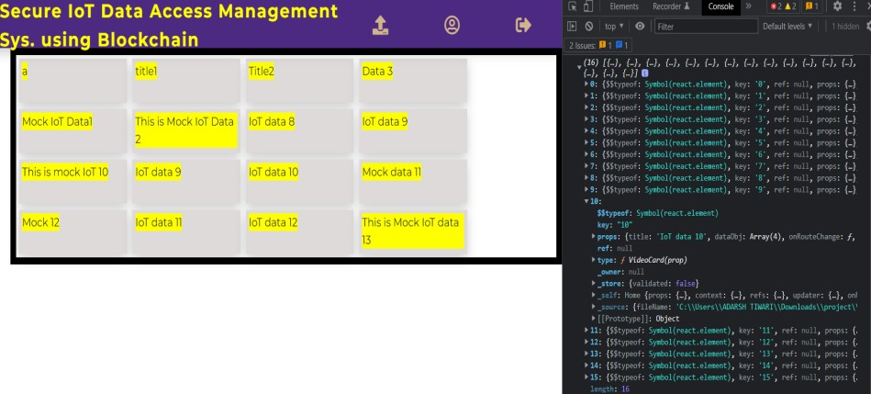
Results
Data Retrieval of all IoT devices:
After hosting the data of 16 simulated IoT devices with the help of smart contract, we need to get all available IoT devices in the network, and it should also render on the client-side application so that the user who wants to get access to any data can request access.
Figure 7: Getting the information (encrypted) for all the devices
Figure 8: All 16 Devices rendering on the client side

Slide 19
Discussion and Conclusion
Decentralized and trustless platform will positively impact the IoT data access management system. This platform provides a reliable and trustless way of IoT data storage and information exchange. Storing and accessing IoT data will positively impact IoT device manufacturers, AI and ML service providers, and end-users.
The project utilizes the Ethereum smart contracts and cryptography algorithms to achieve the objective, resulting in a system where consumers can access information without needing a trusted central authority.

Slide 20
Discussion and Conclusion
This solution also features a robust approach to authenticate and authorize an actor in the system based on a smart contract and the concept of self-sovereign identity

Slide 21
Future work
Integration of the real-time IoT device with the decentralized system in future work. i.e., a data provider can also combine the device with the platform, real-time record data, and host it on the platform.
Automate the transactions in terms of data transferability and payment. In the future, this platform can include some advanced approaches and algorithms to handle data piracy.

Slide 22

Thank You!!!

